Slide 1



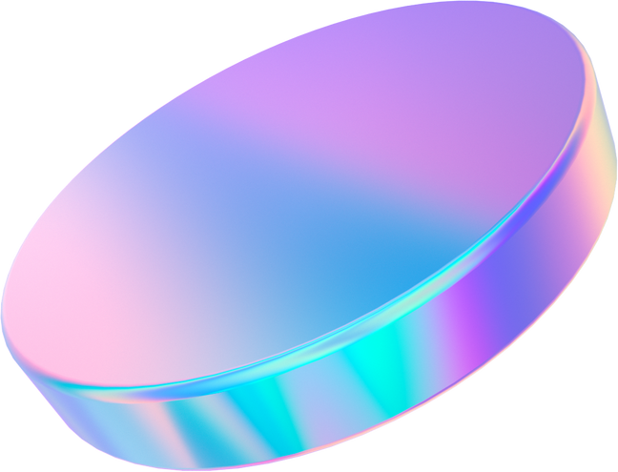
StressLess Shell
De-Stressing Through the Smartphone
Songyan Teng, Jingyao Zheng, Tim Zindulka

Slide 2
Video Placeholder

Slide 3
Sensor Overview
Input Sensors:
Output Sensors:
  Accelerometer
  Gyroscope
  Rotary Encoder
  Button Sensor
  RGB LED
  Buzzer
Notes:
We used accelerometer and gyroscope readings for both stress and phone flip detection. We designed our fidget devices using a rotary encoder for the spinner, and a button sensor, both of which provide satisfying haptic feedback. Three RGB LEDs are used to represent states for three different components: current stress level, phone flip detection, and screen deactivation. We also used a buzzer to indicate when the user’s stress level reaches our preset threshold.

Slide 4
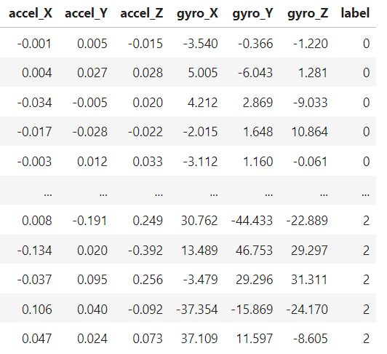
Stress Detection Dataset
  Accelerometer and gyroscope (X, Y, Z axes)
  5 Hz sampling rate
  Three behaviours: not stressed, mildly stressed, very stressed
  Two minutes for each behaviour
Notes:
We collected our stress detection dataset using accelerometer and gyroscope data across the X, Y, and Z axes, captured at a 5 Hz sampling rate as this is the average rate of character entry on smartphones. The data captures three behavioural states: not stressed, mildly stressed, and very stressed, with each behaviour sampled for a duration of two minutes and producing 600 examples. This labelled dataset allowed us to build our classification model.

Slide 5
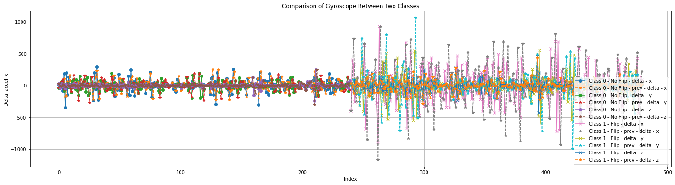
Flip Detection Dataset
  Accelerometer and gyroscope (X, Y, Z axes)
  2 Hz sampling rate
  Two states: flipped, not flipped
  Two minutes for each state
Notes:
Our flip detection dataset was also collected using accelerometer and gyroscope data across the X, Y, and Z axes, captured at a 2 Hz sampling rate. The data captures two phone states: flipped and not flipped, with each state sampled for a duration of two minutes and producing 240 examples. This dataset allowed us to build our rule-based model.

Slide 6
Data Analysis
  Preprocessing: compute features (mean, range, min, max) using deltas over rolling 5-second windows
  Stress detection/classification: random forest with 9 leaf nodes and 8 estimators
  Phone flip detection: rule-based system
  Stress reduction sensing: raw sensor readings
Notes:
After data collection, we preprocessed the data to generate features. We computed the mean, range, minimum, and maximum values from deltas within rolling 5-second windows to capture dynamic typing changes. We used a random forest classifier with 9 leaf nodes and 8 estimators for stress detection and classification. For phone flip detection, we implemented a rule-based system that identifies changes in phone orientation, and for stress reduction, we measured raw sensor readings to gauge how users interact with the fidget toys.

Slide 7



Stress Thresholds
  Not Stressed
  Mildly Stressed
  Very Stressed
  0
  25
  50
  75
  100
$$f\left(x\right)=\left\{\begin{aligned}−1 if x=0 \\ +1 if x=1 \\ +2 if x=2\end{aligned}\right.$$
$$f\left(x\right)=\left\{\begin{aligned}−1 if x=0 \\ 0 if x=1 \\ +2 if x=2\end{aligned}\right.$$
$$f\left(x\right)=\left\{\begin{aligned}−2 if x=0 \\ +1 if x=1 \\ +2 if x=2\end{aligned}\right.$$
Notes:
A user’s overall stress is measured cumulatively, which varies based on their typing behaviour. Each behaviour is given a corresponding “stress value”, which is dependent on the user’s current overall stress level, and is then added to the total. We defined three thresholds for stress measurements, which is reflected as either green, orange, or red through the feedback LED. Upon reaching the maximum stress level of 100, the user receives audio feedback and is asked to flip their phone to interact with the fidget toys,.

Slide 8
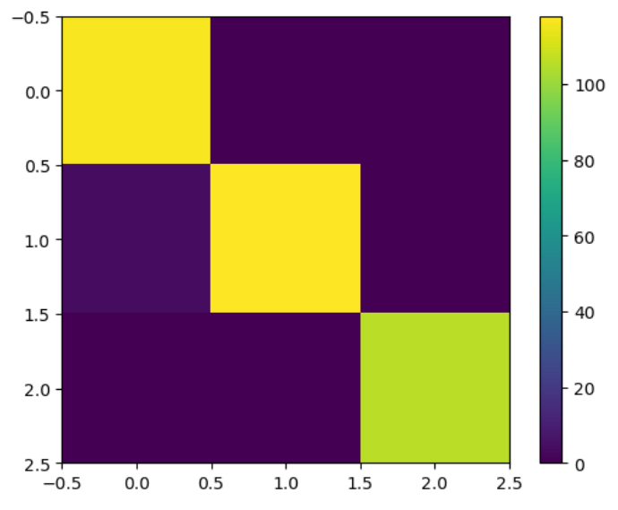
Model Evaluation
0.841
  5-fold cross-validation accuracy
0.96
  F1 Score
Notes:
We conducted 5-fold cross-validation using our random forest model on our stress detection data, where we achieved an accuracy of 0.841. Using an 80/20 train/test split, we achieved an F1 score of 0.96. Our confusion matrix shows that our model makes very few misclassifications on this dataset. The model also exhibited similar accuracies when we deployed it for real-time analysis.

Slide 9
Thank You!

